Slide 1
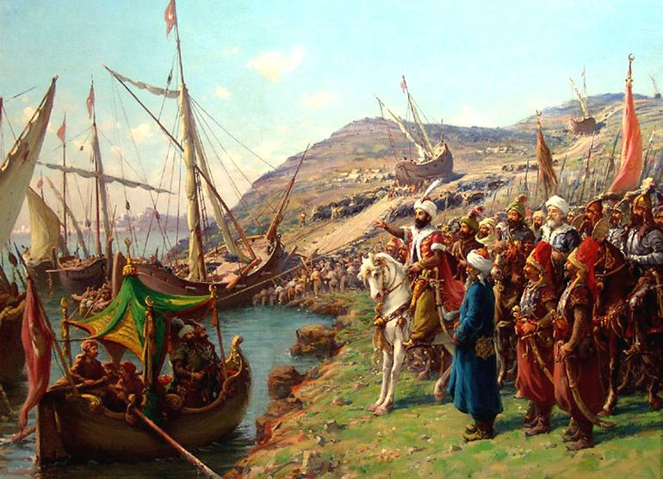
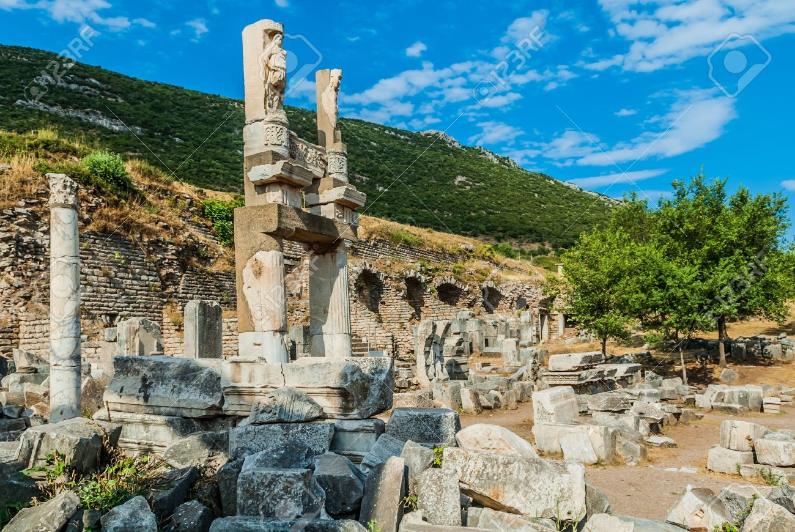
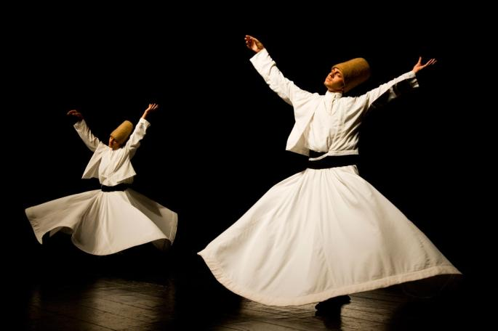
ANATOLIA
Changes
- Initially Christian and Greek speaking.
- After invasion, 90% Muslim and largely Turkic speaking
- Sufi cultural practices dominated
- Transformed into the powerful Ottoman Empire
- Established new infrastructure
Arrival of Islam
- Turkic invaders wreaked havoc and destroyed the Byzantine authority in the 11th century.
- They weakened the Byzantine state and destroyed objects of the Christian church.
- Massacres and famine lead to a sharp drop of original population.
Conversion and Acceptance
- Christians, though seldom forced to convert, faced discrimination.
- Faced social limitations
- Had to pay separate taxes
- Many Christians opposed Islam
- Anatolian society was built on welcoming converts.
- They were granted material rewards
and increased social opportunity.
- Cultural barriers were not severe: Jeudo- Christian people already accepted the same God.
- Sufi practitioners played a major role in the process of conversion
Cultural Developments
- Sufi religious practices like ecstatic turning dances overtook Byzantine dance styles.
- Turkic Islam brought a freer, more gender- equal life for women.
- Women held a more dignified position than other Islamic regions.
Pictured: The Blue Mosque in modern day Istanbul, Turkey
Notes:
Trifold Brochure Directions - Google Presentations/Slides is the best app to use in Google Docs because you can place images, text, and graphics anywhere on the page, unlike Google Docs.
Double Click on “Title of Project” to replace with your text
You can change font, color and outline of this by using the menu bar
The numbers of the pages are marked on the template, delete them when your brochure is complete.
Anywhere there is text, you can replace it with your text
Any place that asks you to insert image can be inserted over top of the text. It won’t show up in final printing
You can change the text box color on pages 3 and 5 so that it is suitable for your project

Slide 2
8/10
Level of Islamization!
Government Organisation
- -Government began as Byzantine state.
- Over time Anatolia became the heart
Religious Institution
- Sufis suggested that Christianity and Islam were two interpretations of the same faith.
- Some rituals, like Sufi turning danes, derived from Turkic shamanism.
- Freer social constructs for women.
Islamization
- Within 400 years they went from Christian and Greek speaking to 90% Islamic with a Turkic language.
-Viewpoint on women in society shifted to become more accepting.
Diffusion of Language and Culture
- Central Asian Turkic shamanistic practices
- Turkic languages spread.

