Slide 1
How did Western people learn to think scientifically?
Factstorm:Working with a partner, list (write) all the facts you know about what science is.

Slide 2
Copy these questions…
Of the 16th-18th Centuries in
Western Europe
Factual Q: What were the Scientific Revolution and the Enlightenment (the Age of Reason)?
Conceptual Q: What were the causes and effects of this Age of Reason?
Debatable Q: How did the Enlightenment affect modern understandings of politics?
Social Contract Theory

Slide 3
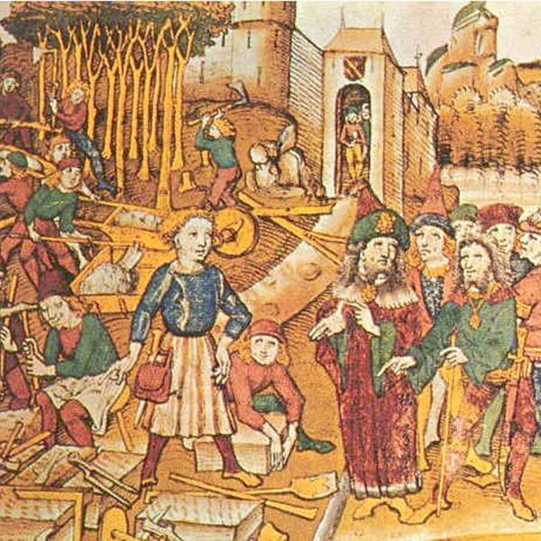
“The Renaissance and the Reformation facilitated the breakdown of the medieval worldview. In the mid-1500’s, a profound shift in scientific thinking brought about the final break with Europe’s medieval past.” (Ellis 434)
http://www.historyonthenet.com/sites/default/files/styles/adaptive/public/Middle_Ages-blarge.jpg?itok=D43T0VsJ
http://images.atelier.net/sites/default/files/imagecache/scale_crop_587_310/articles/422845/atelier-science-trouve-un-second-souffle-crowdfunding.jpg

Slide 4
The Scientific Revolution led to the belief that universal (i.e., they apply everywhere) laws governed the universe and to the belief that nature (non-human and human) could be known by people.

Slide 5
What contributed to scientific thinking in the Western World?
The Medieval Catholic Scholastics said you could use faith, reason, and observation.
Thomas Aquinas had five “rational proofs” for God. For example, all things are moving, so there must be a first mover.
Can you justify or critique this thinking?
http://www.ericscheske.com/blog/wp-content/uploads/2008/09/Thomas%20Aquinas.jpg

Slide 6
What contributed to scientific thinking in the Western World?
The Renaissance brought more money, the rise of the middle class, stronger governments and more education.
The Reformation showed that people could think more differently as they developed new sects of Christianity and that they could even challenge Christian teachings and the Catholic Church.
http://english.uchicago.edu/graduate/british/images/renaissance.jpg

Slide 7
How would you philosophically prove that you exist?
Work with a shoulder partner to answer this question.

Slide 8
Descartes…one of the first rationalists (used his reason) of the Scientific Revolution
Rene Descartes believed he had to get rid of all his previous knowledge, biases, and ideas to start thinking rationally. What biases would you have to get rid of?
He concluded by saying, “I think, therefore I am.” Why do you think he reached this conclusion?
Based on his quote, what is the only thing Descartes trusted?
http://faculty.uml.edu/enelson/images/Descartes.jpg

Slide 9
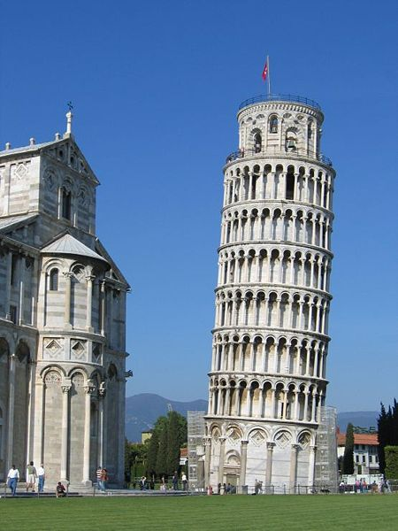
A New Type of Reasoning
Inductive Reasoning
You observe first without creating a “big idea”.
Then you create experiments to test what you see.
Then, you form theories based on the evidence you see.
Modern scientists use both deductive and inductive reasoning.
Pair and Share: Why would they use both? How do they interpret cause and effect?
http://www.aroundtheplanet.org/wp-content/uploads/2008/04/pisa.jpg

Slide 10
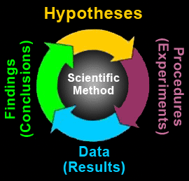
Another View of the Scientific Method
http://web2.newtown-h.schools.nsw.edu.au/Science/CommonFolder/index_files/E1_ScientificMethod.gif

Slide 11
Medieval “scientists” relied on ancient Greeks like Ptolemy.
Ptolemy, an ancient Greek philosopher using reason, taught the geocentric theory that the sun goes around the earth. The Catholic Church agreed with him.
http://www.ivegotatheoryaboutthat.com/images/geocentric.jpg

Slide 12
Example of New Scientific Thinking
Copernicus and Galileo, through the use of reason, observation and technology (telescope) proved that the heliocentric theory that the sun in the center of the solar system is correct.
http://amazing-space.stsci.edu/resources/explorations/groundup/lesson/basics/g37/graphics/g37_copernicus.gif

Slide 13
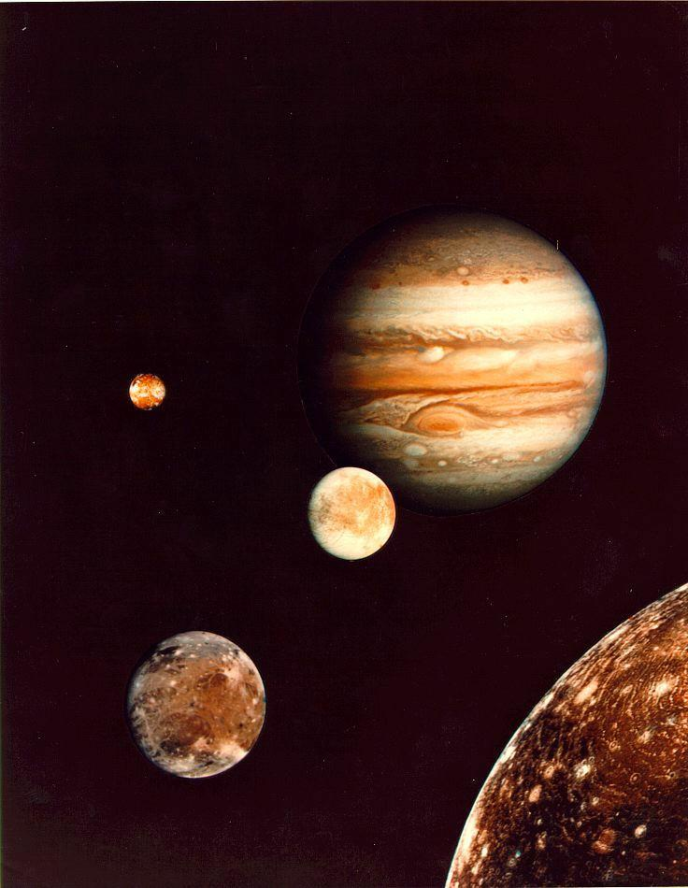
http://physics.uoregon.edu/~jimbrau/astr121/Notes/Jupiter/jupiter_family.jpeg

Slide 14
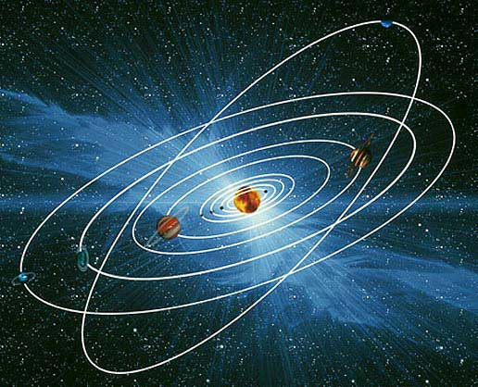
http://www.bbc.co.uk/schools/ks3bitesize/science/images/planets_orbits.jpg

Slide 15
Example of New Thinking
Isaac Newton, using reason and experiments, thought that universal natural laws, like gravity, worked the same way throughout the universe.
Others would come to believe that people were governed by natural laws.
http://csmh.pbwiki.com/f/Isaac%20Newton%20apple.JPG

Slide 16
Newton’s Laws of Motion
https://www.youtube.com/watch?v=08BFCZJDn9w
https://www.youtube.com/watch?v=qu_P4lbmV_I
https://www.youtube.com/watch?v=e1lzB36aHD4
http://www.sciencetoymaker.org/balloon/images/newton.gif

Slide 17
Westerners Started to Experiment
Scientists realized that reason and observation wasn’t enough. They needed controlled investigation or well-constructed experiments.
Francesco Redi proves that rotting meat doesn’t magically produce maggots.
http://www.bayerhome.co.za/media/SchoolProjects/flyOnMeat.jpg

Slide 18
Scientists of the Scientific Revolution
William Harvey mapped the body’s circulatory system.
Robert Boyle identified chemicals as the basic building blocks of matter.
Isaac Newton identified the force called gravity.

Slide 19
What happens when you turn a light on in a dark room?
http://www.homelightingtips.org/wp-content/uploads/2014/06/lamp-light-objects.gif

Slide 20
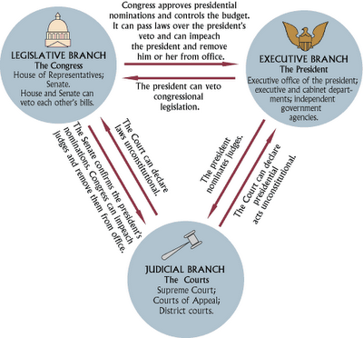
The Scientific Revolution, in part, leads to the Enlightenment…The Age of Reason.
Enlightenment thinkers, like Hume, Locke, Jefferson, and others wanted to apply rationality and the scientific method to problems in other fields such as government, law, and economics to make the world better and more just.
http://csmh.pbworks.com/f/Power%20Separation.png

Slide 21
This led to Enlightenment Revolutions, such as the Glorious Revolution in England, the American Revolution and the French Revolution. All of these, to some degree, stressed protecting the natural rights of the citizens.

Slide 22
Read the quote from Kant on the next slide and write a response critiquing his ideas. Where do you agree and where do you disagree? Why would it have been necessary, in Kant’s POV, to say this?

Slide 23
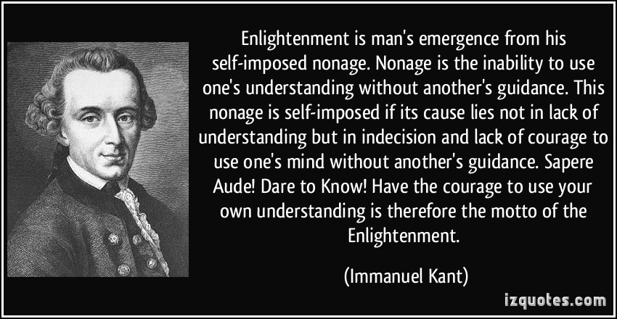
http://izquotes.com/quotes-pictures/quote-enlightenment-is-man-s-emergence-from-his-self-imposed-nonage-nonage-is-the-inability-to-use-one-s-immanuel-kant-345626.jpg

Slide 24
Many Westerners turn to a religious belief known as Deism.
Deism is the idea that God created the universe and then “left” man to figure out the laws of the universe.
The early modern world takes a major step to materialism (focused on this world) and secularism (non-religious).
http://www.decor-medley.com/grandfather-clocks.html

